Slide 1

03 March 2026
TN CyberTech Bank Website Report

Slide 2
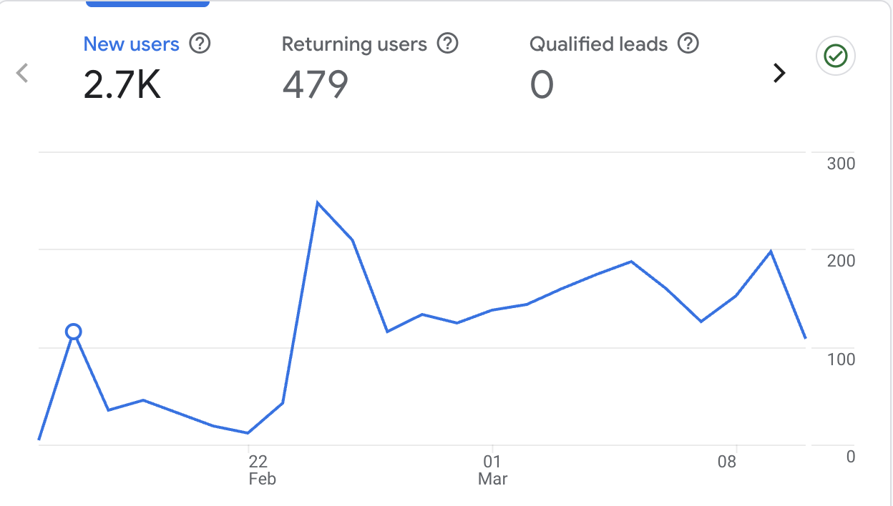
Site Overview
The large line chart on the right displays the key metrics for the TN CyberTech Bank website from the day we went live.
It shows:
Total Users : 2.7K users visited the site.
Returning Users : 479 users returned back to browse the website.
Average Engagement Time : Users spent an average of 1m 13s seconds on the site.

Slide 3
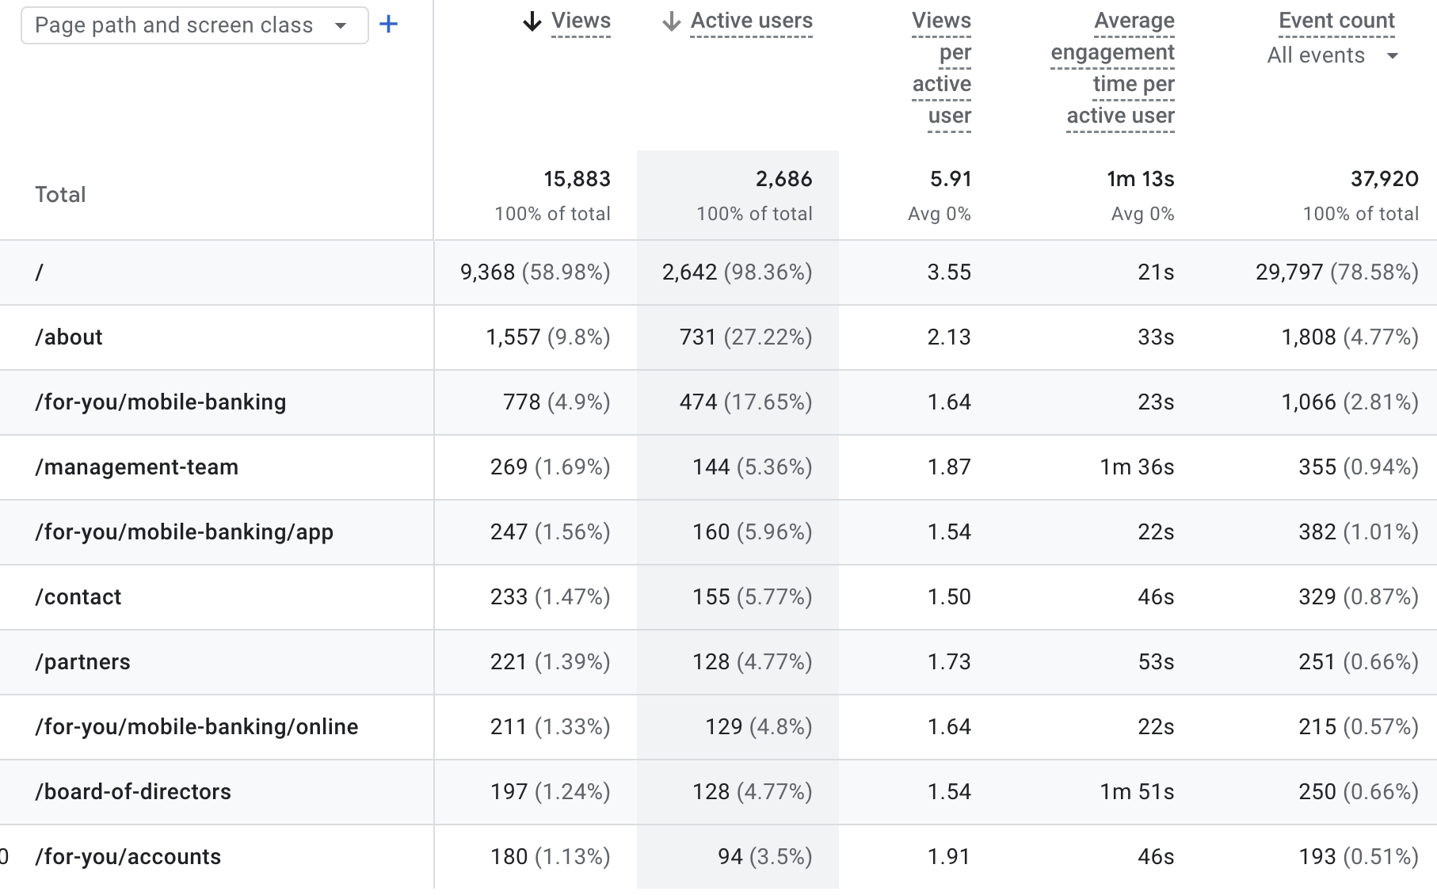
Pages Sessions
15,883 total page views were recorded from 2,686 active users.
Users viewed an average of 5.91 pages per session.
The homepage ( / ) received the highest traffic, accounting for 58.98% of all views.
The About page is the second most visited page, showing strong interest in company information.
Mobile Banking pages also received notable traffic, indicating interest in digital banking services.
Average user engagement time was 1 minute 13 seconds, showing steady interaction with the site.

Slide 4
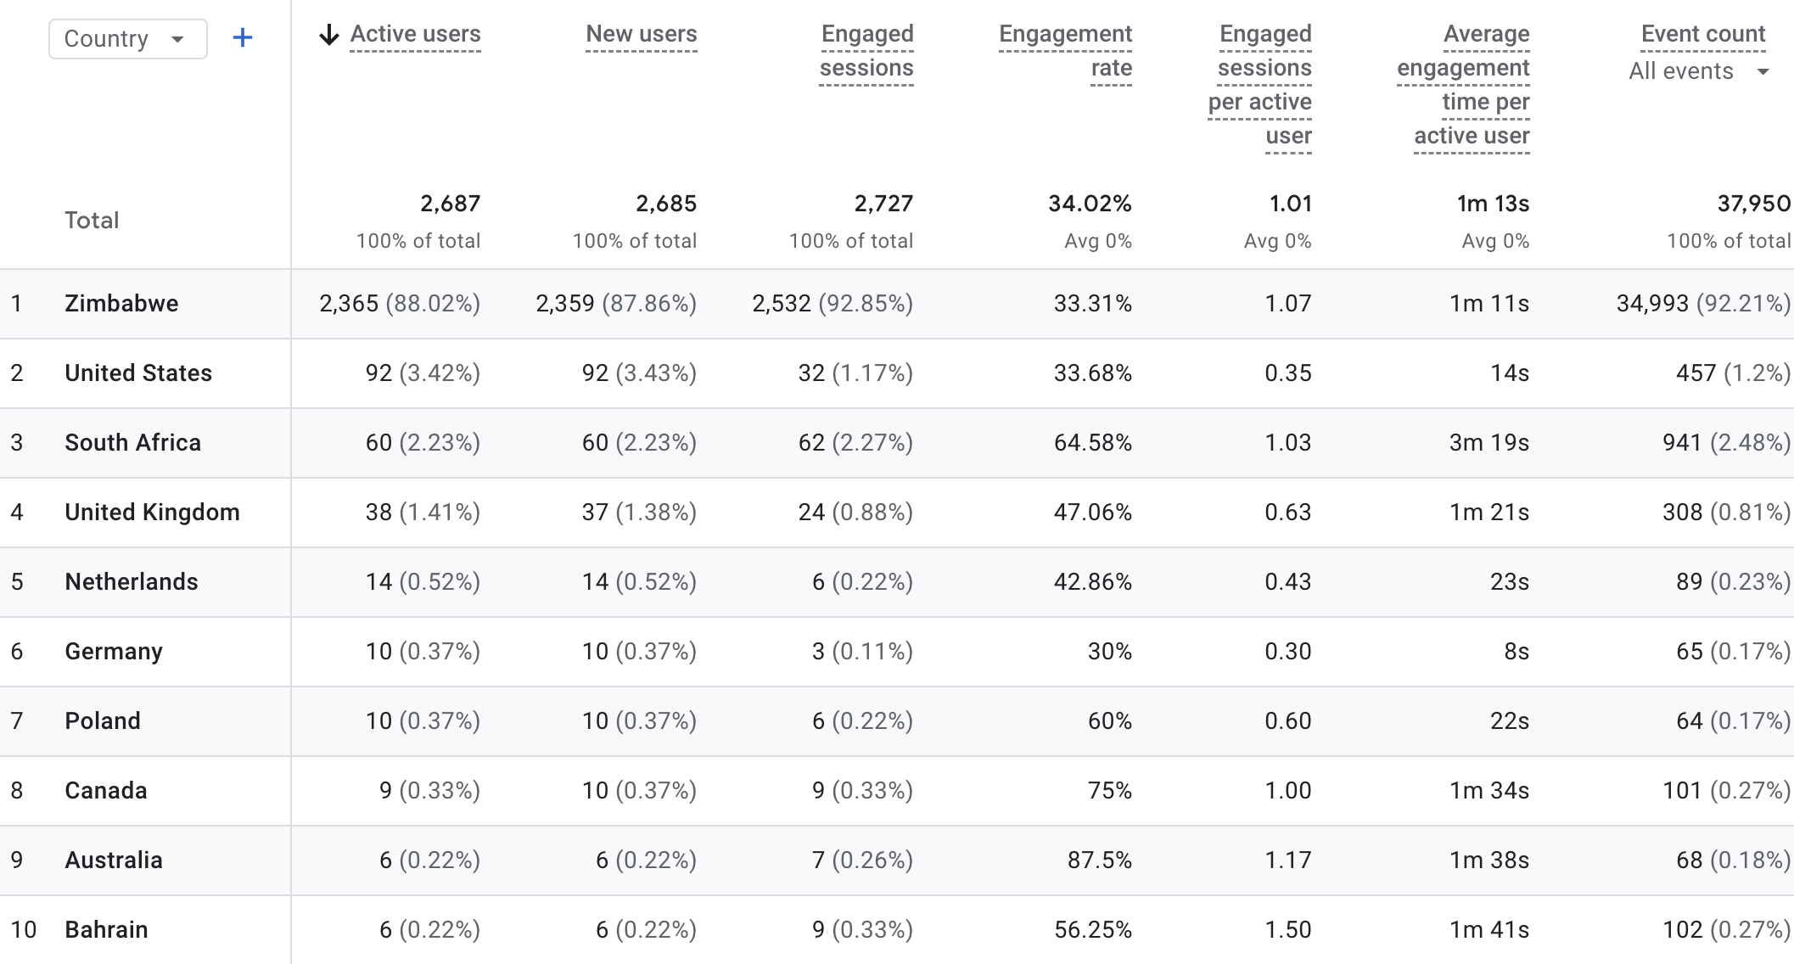
Demographic Overview

Slide 5
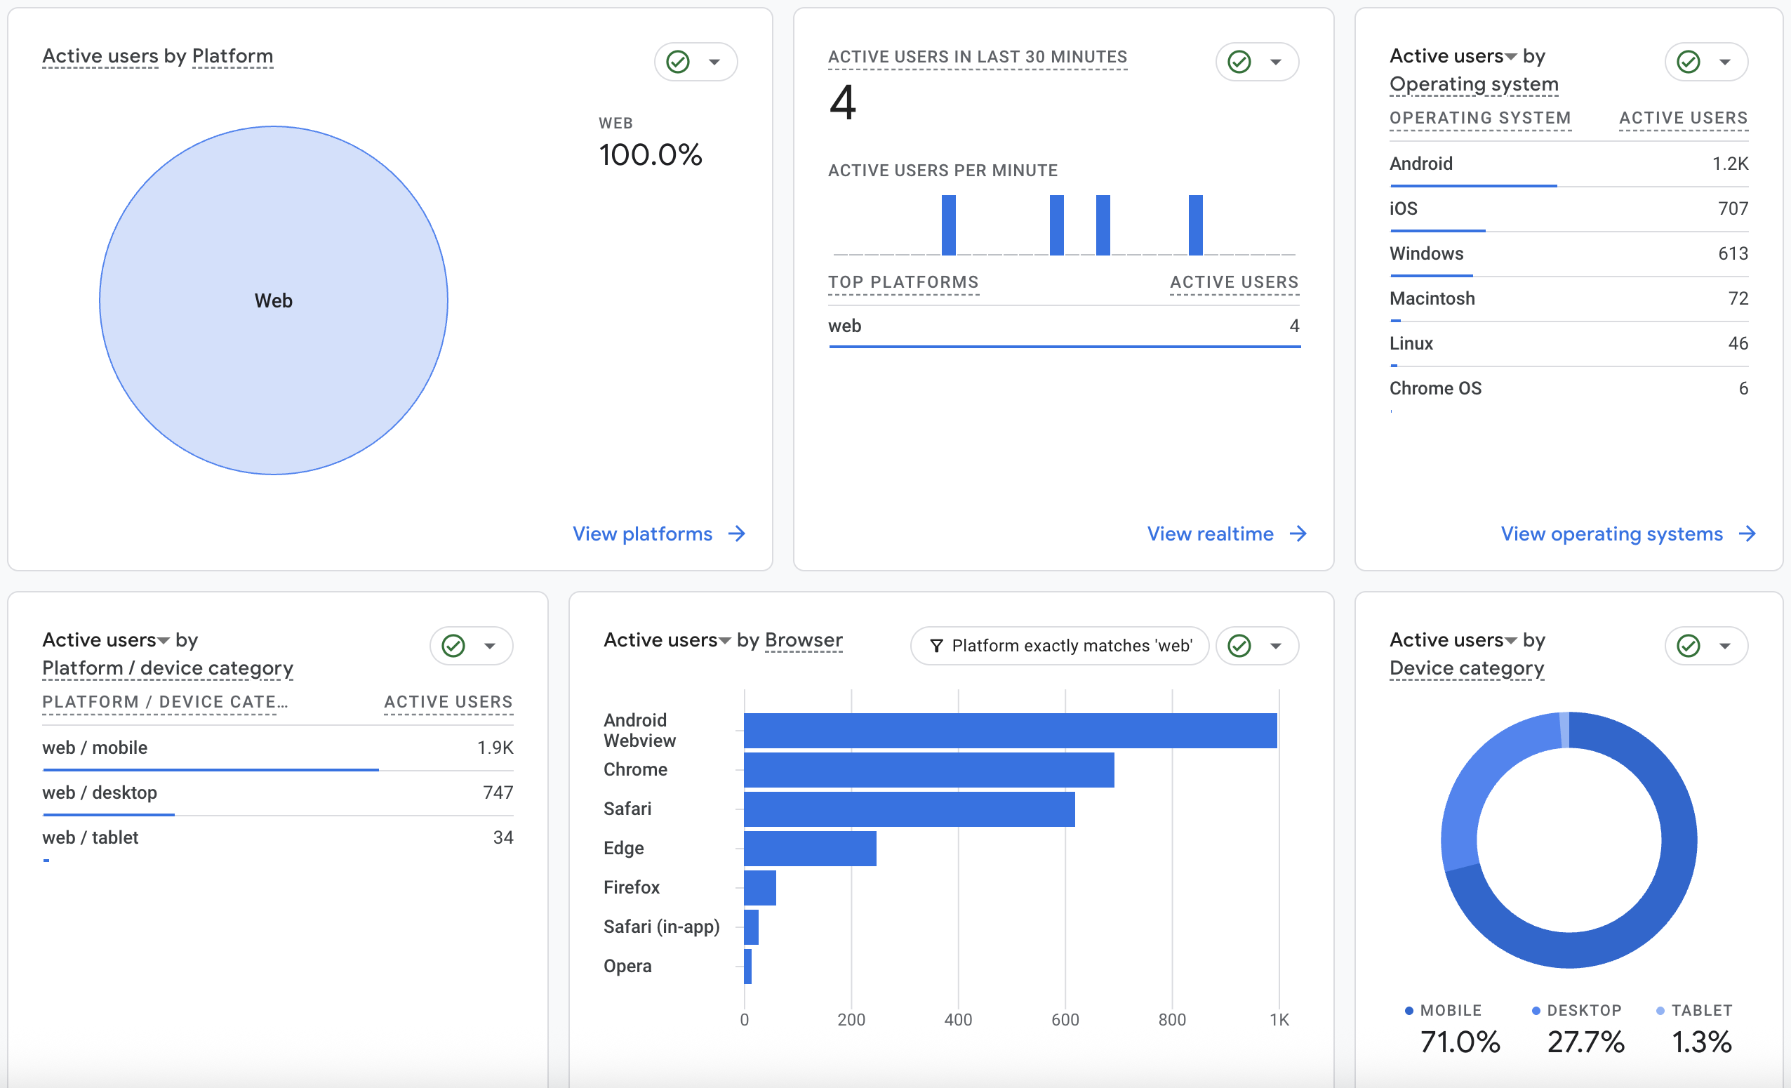
Tech Overview

Slide 6
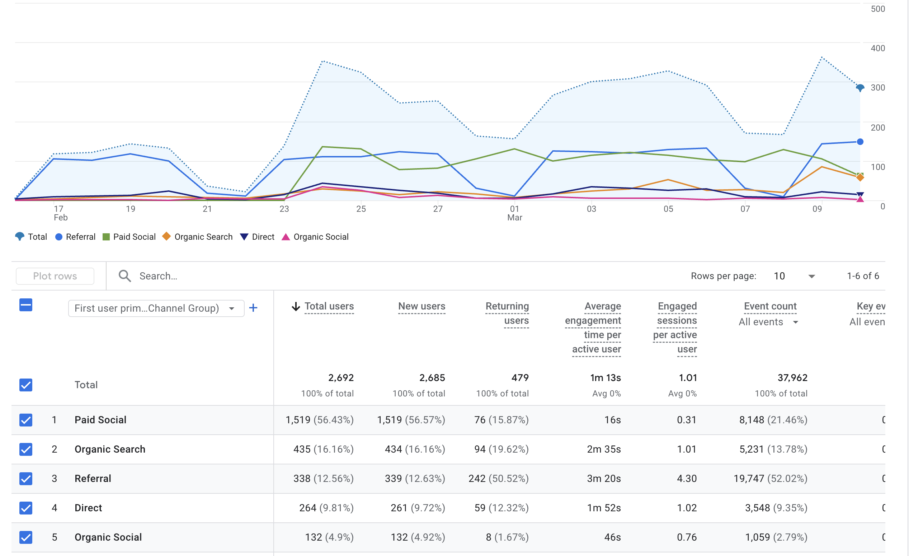
Traffic Sources
Paid Social is driving the bulk of your traffic (56%), but with a very low average engagement time of just 16 seconds, suggesting these users aren't finding what they need. In contrast, Referral traffic is your highest-performing channel; despite having fewer users, it accounts for over 52% of all site events and keeps people on the site for over 3 minutes. Essentially, you are successfully reaching new people through ads, but your most valuable, engaged actions are coming from external site links and organic searches

Slide 7
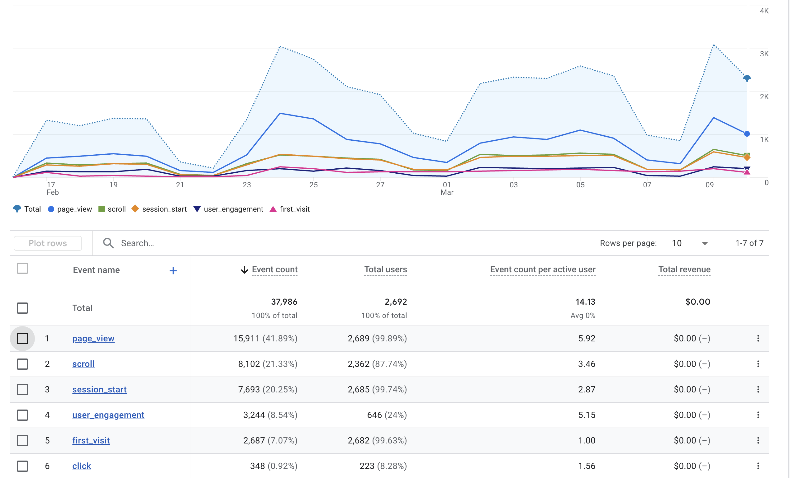
Events Overview
Page Views and Scrolls account for over 60% of total activity
Most users start sessions and view pages, but engagement is low
Only 24% trigger a user engagement event
Less than 1% click on specific elements
Traffic shows sharp spikes and drops, indicating dependence on campaigns or periodic updates

Slide 8

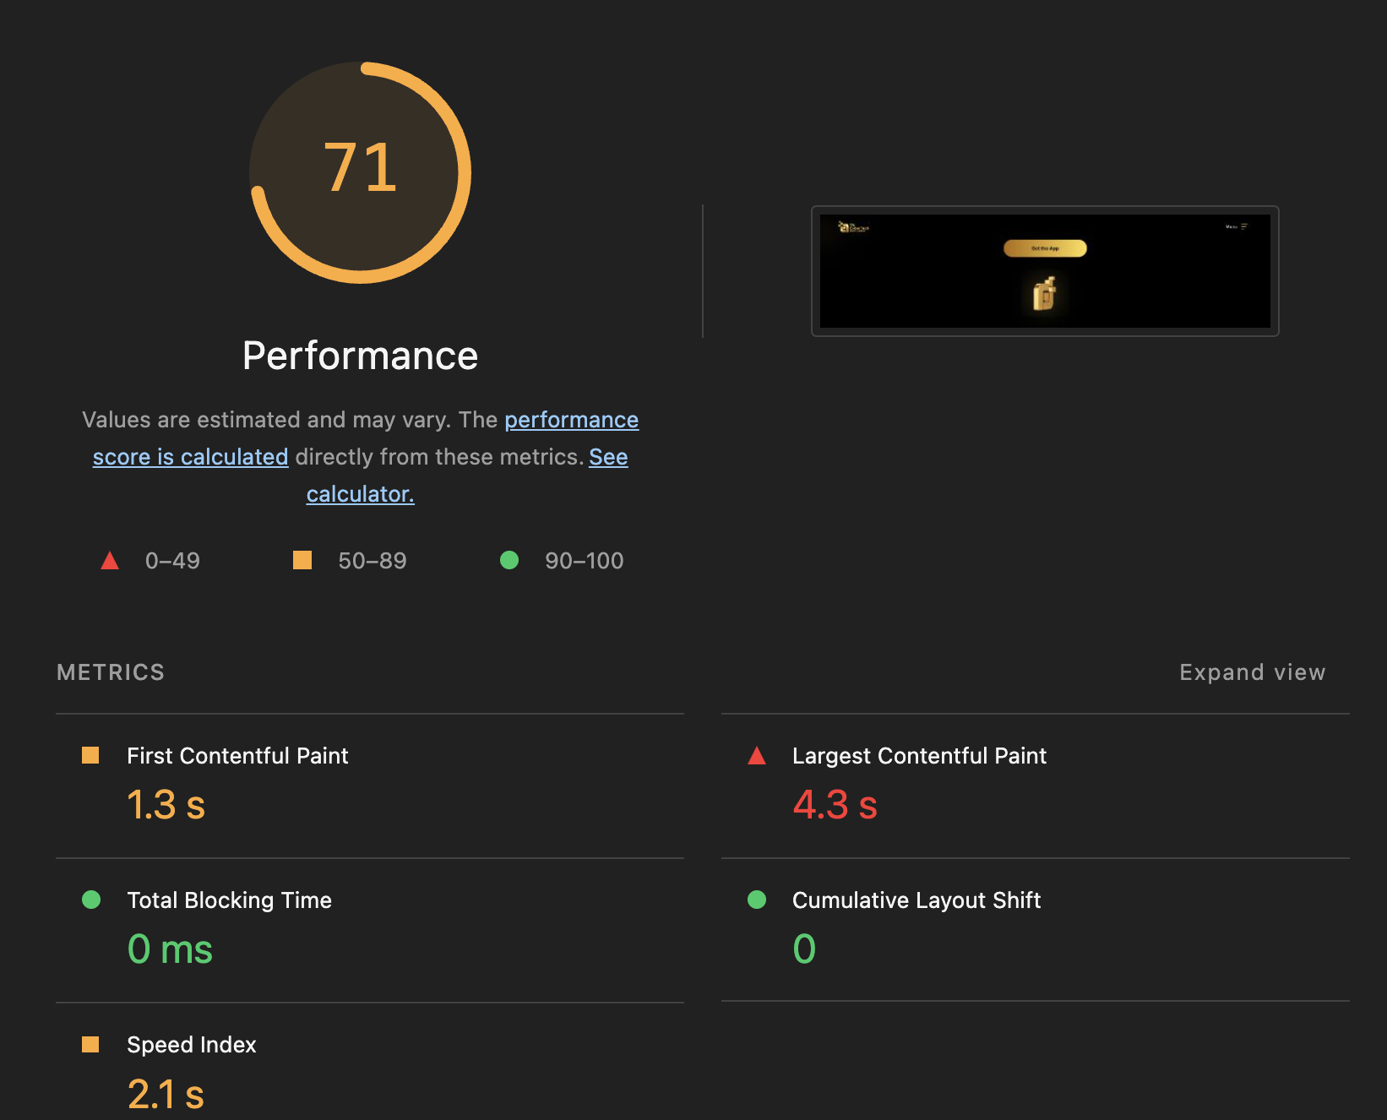
Performance Overview

Slide 9
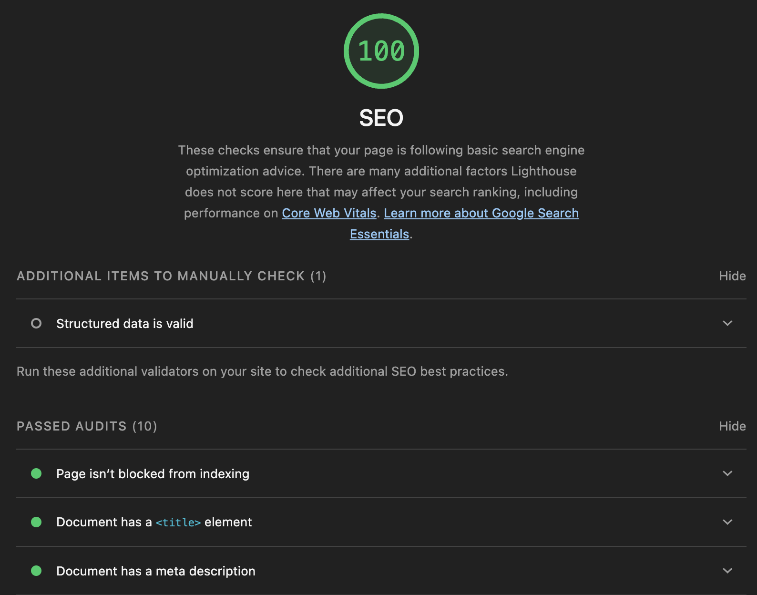
SEO Results

Slide 10
Recommendations
Improve Paid Social Quality: Align ad messaging with landing pages to increase the current 16-second engagement time.
Scale Referral Channels: Invest in partnerships with referring sites, as they drive 52% of all interactions.
Optimize Mobile Speed: Reduce the 4.3s Largest Contentful Paint to better serve the 71% of users on mobile devices.
Boost Lead Conversion: Add clear Call-to-Actions (CTAs) to convert the high volume of page views into "Qualified Leads," which currently sits at zero.

